Slide 2



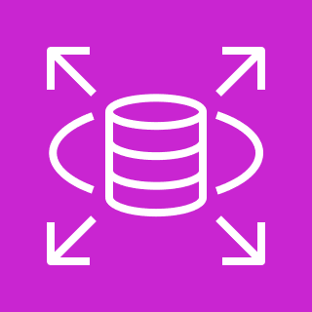


Architecture Diagram
3
Open Data Portal
4
Amazon RDS
Console App
Apache Superset
1
1
Ingestion
2
Extract Transform Load
3
Storage
Databricks (Apache Spark)
2
4
Reporting

Slide 4
1
Ingestion
2
Extract Transform Load
3
Storage
4
Apache Superset

